Slide 1
Algebraic Topology and Distributed Computing
Maurice Herlihy
Brown University

Slide 2
Overview
Focus on applications of algebraic topology to fault-tolerant computing
  model
  techniques
Joint work with Sergio Rajsbaum, Nir Shavit, Mark Tuttle

Slide 3
First Part of Talk
Focus on one problem
  Consensus
One model of computation
  synchronous message-passing
Motivation:
  results not new (those come later)
  but illustrate model

Slide 4
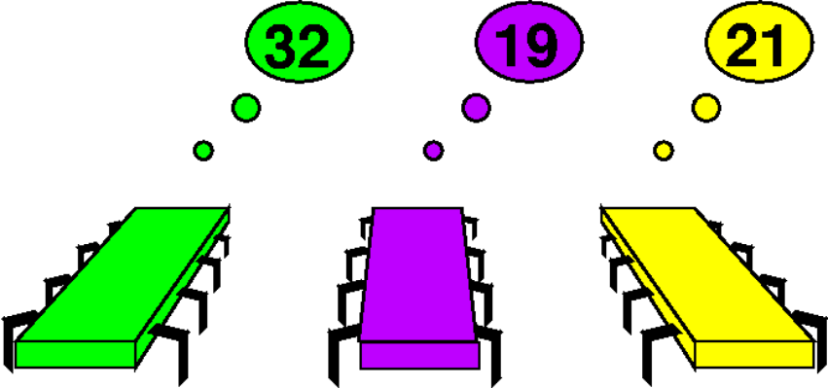
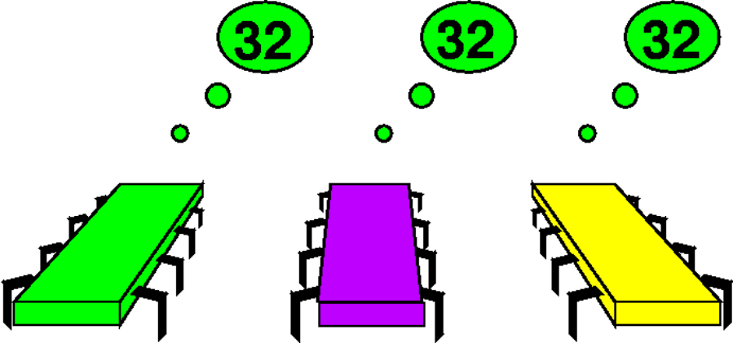
The Consensus Task
Before: private inputs
After: agree on one input

Slide 5

The Model: Synchronous Message-Passing
Round 0
Round 1

Slide 6
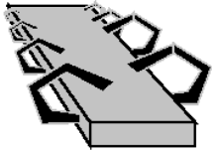
Failures: Fail-Stop
Partial broadcast

Slide 7
Summary
Consensus
  all processes agree on some input
Model
  processes run in lock-step
  non-faulty processes broadcast
  faulty processes broadcast to subset

Slide 8
Road Map
Next: mathematical model
  combinatorial topology
  no interesting mathematics (yet)
  but want to focus on model
  and basic approach

Slide 9
A Vertex
Point in high-dimensional Euclidean Space

Slide 10
Simplexes
0-simplex (vertex)
1-simplex (edge)
2-simplex (solid triangle)
3-simplex
(solid tetrahedron)

Slide 11
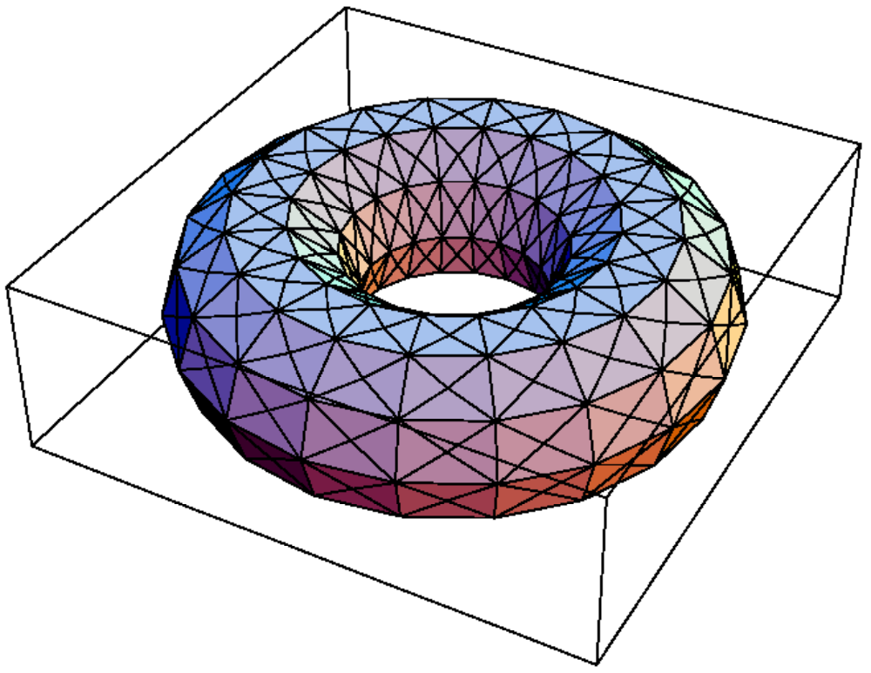
Simplicial Complex

Slide 12
Simplicial Maps
Vertex-to-vertex map
carrying simplexes to simplexes
induces piece-wise linear map

Slide 13
Vertex = Process State
Process id (color)
7
Value (input or output)

Slide 14
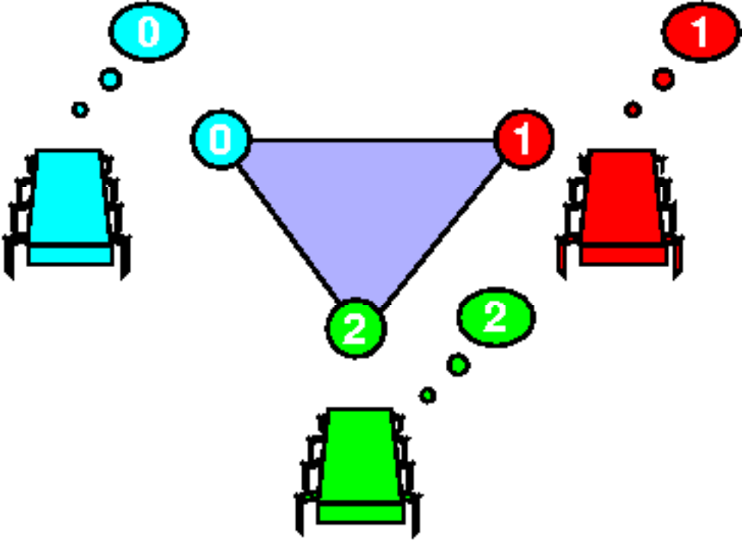
Simplex = Global State

Slide 15
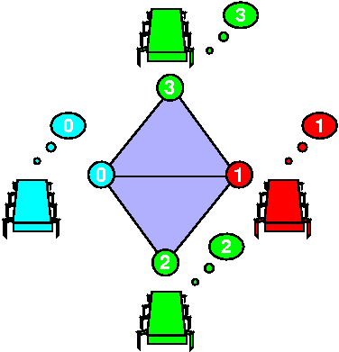
Complex = Global States

Slide 16
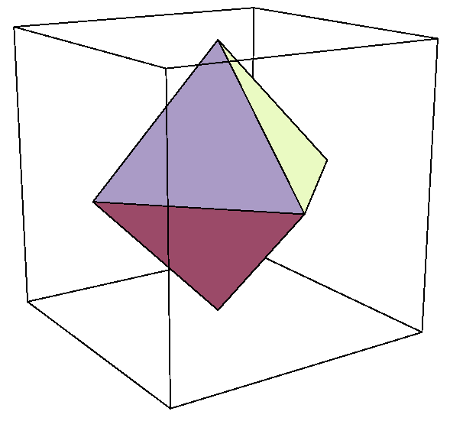
Initial States for Consensus
0
Processes: blue, red, green.
Independently assign 0 or 1
Isomorphic to 2-sphere
the input complex
0
1
0
1

Slide 17
Final States for Consensus
Processes agree on 0 or 1
Two disjoint n-simplexes
the output complex
0
0
0
1
1
1

Slide 18
Problem Specification
For each input simplex S
relation Δ(S)
  defines corresponding set of legal outputs
  carries input simplex
  to output subcomplex

Slide 19
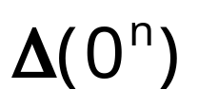

Consensus Specification
0
0
0
1
1
1
Simplex of all-zero inputs

Slide 20
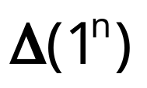

Consensus Specification
0
0
0
1
1
1
Simplex of all-one inputs

Slide 21
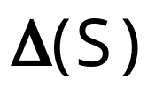

Consensus Specification
0
0
0
1
1
1
Mixed-input simplex

Slide 22
Protocols
Finite program
starts with input values
fixed number of rounds
halts with decision value

Slide 23
Generic Protocol
Number of rounds
s = empty sequence
for (i=0; i<r; i++) {
broadcast messages
s = s + messages received
}
return δ(s)
Decision map

Slide 24
Protocol Complex
Each protocol defines a complex
  vertex: sequence of messages received
  simplex: compatible set of vertexes
Treat as operator on input simplex
Model of computation defines protocol complex properties

Slide 25
Single Input: Round Zero
No messages sent
vertexes labeled with input values
isomorphic to input simplex
0
0
0

Slide 26
Round Zero Protocol Complex
0
No messages sent
vertexes labeled with input values
isomorphic to input complex
0
1
0
1

Slide 27
Single Input: Round One
red fails
green fails
0
0
0
0
0
0
0
0
0
0
0
0
0
0
0
0
0
no one fails
blue fails
0
0
0
0

Slide 28
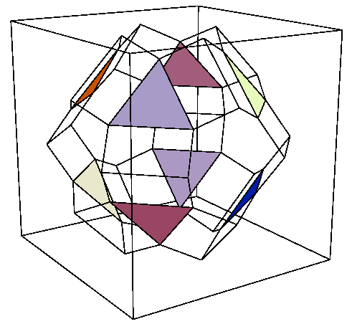
Protocol Complex: Round One

Slide 29
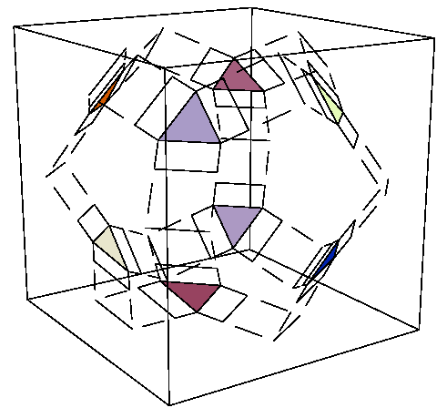
Protocol Complex: Round Two

Slide 30
Protocol Complex Evolution
zero
one
two

Slide 31
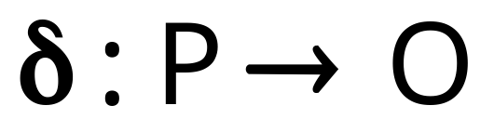
Observation
Decision map
is a simplicial map
  vertexes to vertexes, but also
  simplexes to simplexes
  respects specification relation Δ

Slide 32
Summary
δ
Protocol complex
Δ
Input complex
Output complex

Slide 33
Proof Strategy
δ
Find topological “obstruction” to this simplicial map
Protocol complex
Output complex

Slide 34
Consensus Example
Subcomplex of all-zero inputs
δ
Protocol
Output
must map here

Slide 35
Consensus Example
Subcomplex of all-one inputs
δ
Protocol
Output
must map here

Slide 36
Contradiction
not connected
δ
Protocol
Output
connected

Slide 37
Theorem
In any (n-1)-round protocol complex
  the all-zero subcomplex
  and the all-one subcomplex
  are connected
Corollary:
  no (n-1)-round consensus protocol

Slide 38
Remarks
Consensus result is
  not exactly new [PSL 80]
  and doesn’t really need topology
but illustrates basic approach
  use topological techniques
  to prove non-existence of simplicial map

Slide 39
Next Part of Talk
Connectivity of protocol complexes
  define notion
Analyze protocol complexes for
  message-passing
  read/write memory
  memory with stronger operations

